Slide 1
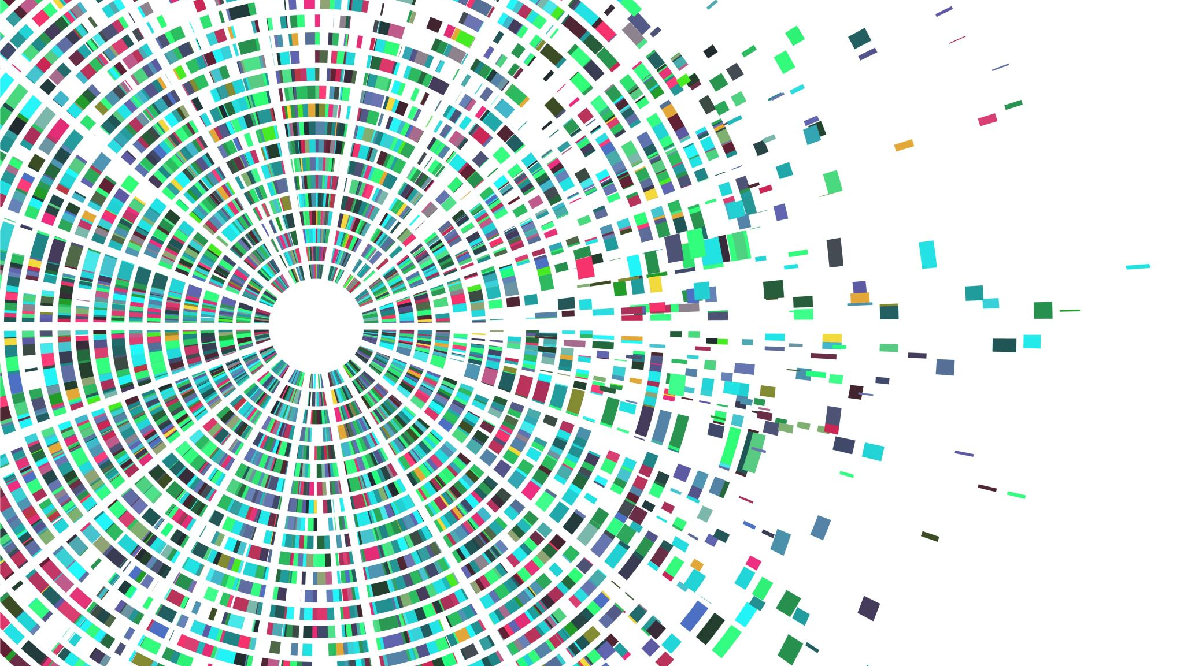
What is open science?
Nicholas Franklin
Harvard University
“Becoming a good scientist”
April 27, 2020

Slide 2
What is open science?
Goals
Methods
Democratic?
Equal Access to knowledge
Pragmatic?
Working together -> greater efficiency
Infrastructure?
Research depends on the availability of tools
Public?
Science is not just for scientist.
Measurement?
how do we measure progress?
Open Data
Open Access
Open Methods
Altimetric
Pear review
Collaboration platforms and tools
Intellectual property rights
Blogging / Public communication
Fecher & Friesike, 2013

Slide 3
Open Science: pragmatic view
Science should be repeatable, reproducible and should replicate.
 |  | Data
 |  | Same | Different
Analysis | Same | Reproducible | Replicable
 | Different | Robust | Generalisable
https://the-turing-way.netlify.com/reproducibility/03/definitions.html
#PyDataLDN #TuringWay @kirstie_j
https://doi.org/10.5281/zenodo.3333760

Slide 4
Open Science: pragmatic view
Science should be repeatable, reproducible and should replicate.
“Open Science”
Share data, materials and/or code
Accelerate communication with preprints
Increase transparency through registration.
Argument: open science promotes higher quality work and accelerates science

Slide 5
Open Science: pragmatic view
Open Methods
Pregistration / Registration
Demonstrate replicability empirically
Open Data: sharing data and code
Allows others to evaluate your work (reproducible)
Encourages consistency and best practices
Facilitates similar studies by different groups (replicability)
Open Access:
Preprints, public availability allow for increased feedback prior to publication
“Time-stamps” – lower barriers to open data

Slide 6
When to open science?
BEFORE/DURING
Preregistration
Registered reports
STAGE OF
RESEARCH PROCESS…
DURING
Documentation
Version control
Code review
Code & data repositories
AFTER
Websites & Twitter
Preprints
Research output sharing platforms

Slide 7
Registration
No p-hacking!

Slide 8
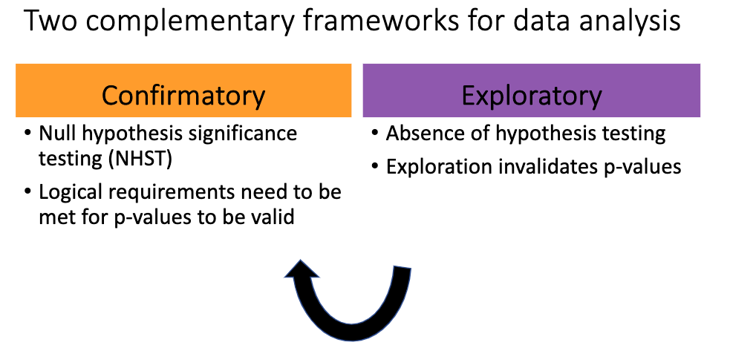
We need both more rigor in confirmatory analyses,
and more value accorded to exploratory analyses
Pfeifer, Jennifer (2019): Flux_Pfeifer_2019_FINAL.pdf. figshare. Presentation. https://doi.org/10.6084/m9.figshare.9848657.v2

Slide 9
Preregistration
Confirmatory: you know the experiment that you will run and how you will analyze the data
Publish your methods before you perform the experiment
How: upload pdf on osf.io
Benefits:
Prevent p-hacking
Reduce flexibility in drawing a favorable conclusion
Build confidence!

Slide 10
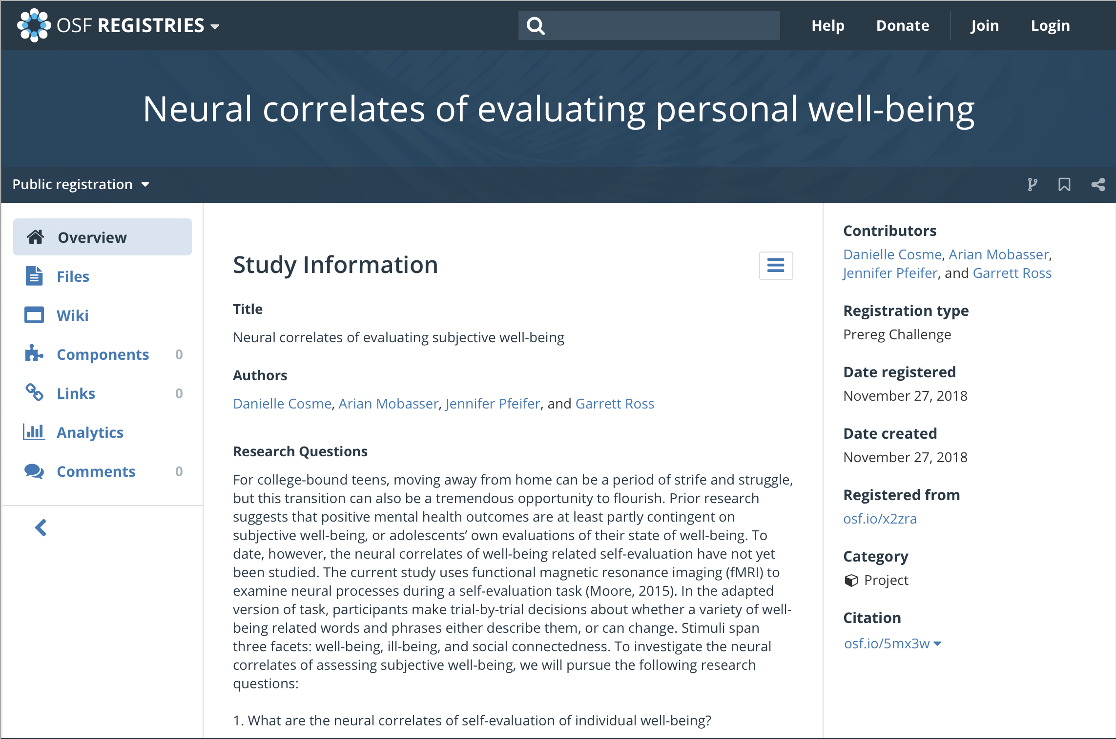

Slide 11
Crowd-sourced preregistration resources
Example 1
Example 2
Notes:
Note (NTF): pause to show example pre-registration here. I have one to show

Slide 12
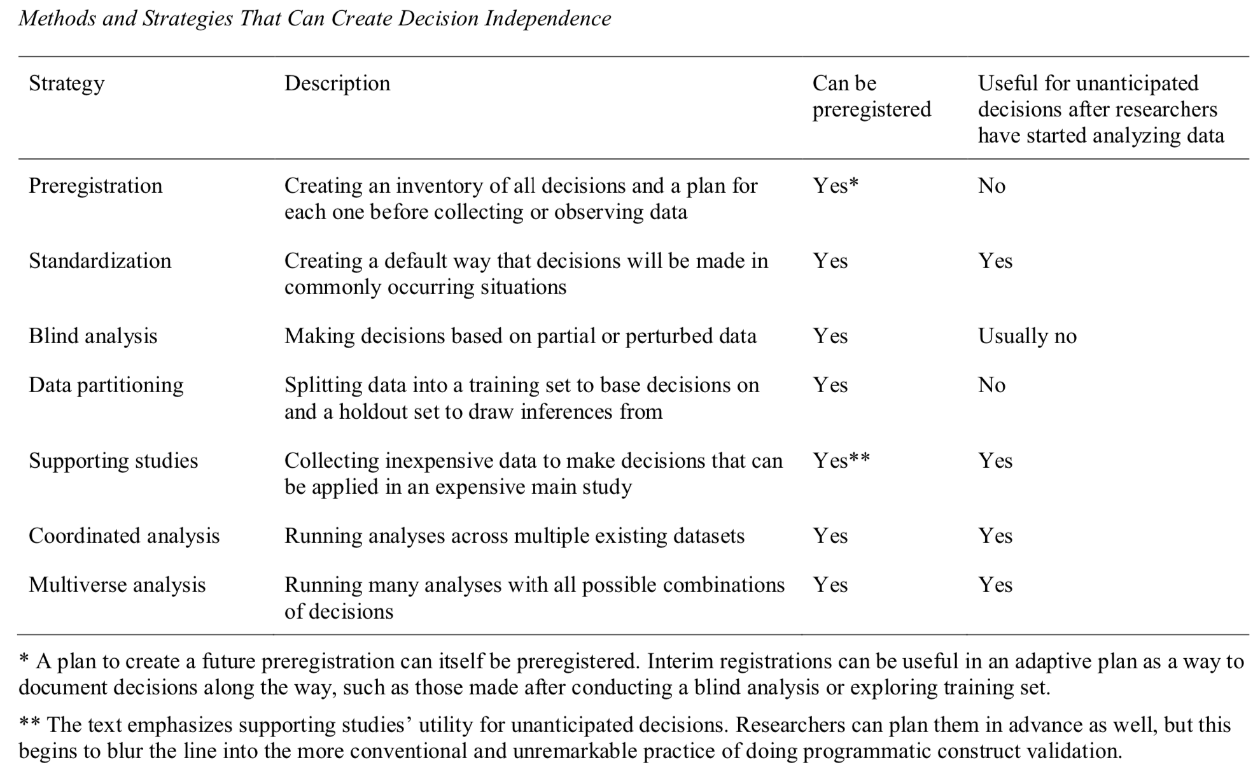
Srivastava, S. (2018, November 21). Sound Inference in Complicated Research: A Multi-Strategy Approach. https://doi.org/10.31234/osf.io/bwr48

Slide 13
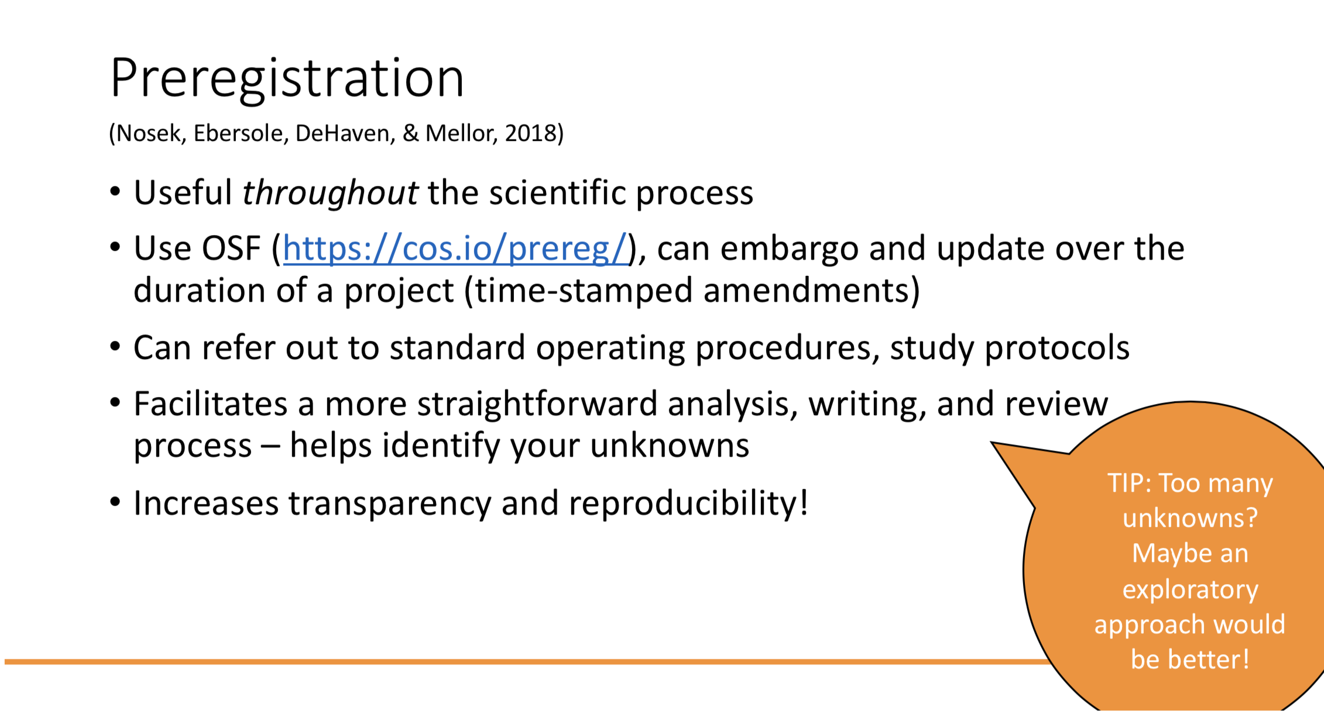
Pfeifer, Jennifer (2019): Flux_Pfeifer_2019_FINAL.pdf. figshare. Presentation. https://doi.org/10.6084/m9.figshare.9848657.v2

Slide 14
Registered reports
Similar reasoning to preregistration
But undergoes peer review before you run the study/analyses
Advantages:
Can see what reviewers think before you run the study, so you can modify things as necessary
If your methods and analysis plan is sound, publishing is not tied to the outcome of the study
Disadvantages: relatively uncommon, lack of support by journals.

Slide 15
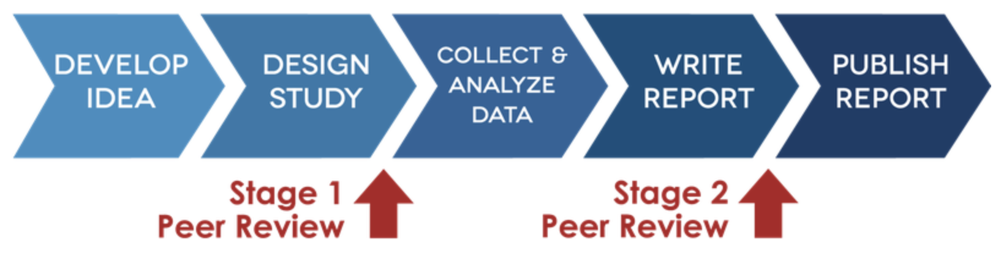
Registered reports
In-principle acceptance
In-principle acceptance based on the importance of the research question and rigor of research methods
Adapted from https://cos.io/rr/
Notes:
Can include any pilot data you have

Slide 16
Registered reports
Unchanged: Intro, Methods
New: Results, Discussion
Data/materials deposited in public archive
In-principle acceptance
Adapted from https://cos.io/rr/
Notes:
In-principle acceptance based on: importance of research question and rigor of methods
Stage 2 peer review: reviewers assess
Can withdraw your manuscript, don’t HAVE to publish

Slide 17
Registered reports
Unchanged: Intro, Methods
New: Results, Discussion
Data/materials deposited in public archive
In-principle acceptance
Full
acceptance
Reviewers assess compliance and whether conclusions are evidence-based
Adapted from https://cos.io/rr/
Notes:
In-principle acceptance based on: importance of research question and rigor of methods
Stage 2 peer review: reviewers assess
Can withdraw your manuscript, don’t HAVE to publish

Slide 18
Registered reports
Unchanged: Intro, Methods
New: Results, Discussion
Data/materials deposited in public archive
In-principle acceptance
Full
acceptance
MORE ON REGISTERED REPORTS:
Bishop, D. V. M., Chambers, C., & Munafo, M. R. (2019, January 8). Chambers.
osf.io/yvr9q
Adapted from https://cos.io/rr/
Notes:
Can withdraw your manuscript at any time, don’t HAVE to publish

Slide 19
Open Data
Creating reproducible workflows

Slide 20
Creating reproducible workflows
Documentation
Version Control
Code Review
Code & Data Repositories
Tip: it is easier to start your analysis with the assumption that you will share it than it is to go back and clean up everything at the end.

Slide 21
Idealized Product:
Single, well-documented program creates all figures and analyses in your paper from raw data with no manual interventions
Why?
Reduce potential for errors
Reuse
Sharing

Slide 22
Documentation
Simple things matter: people need to understand your work
Start with the assumption someone else will read your code and not know what it does.
That person will be you.
Write your code to be clear, and it will be easier to share later

Slide 23
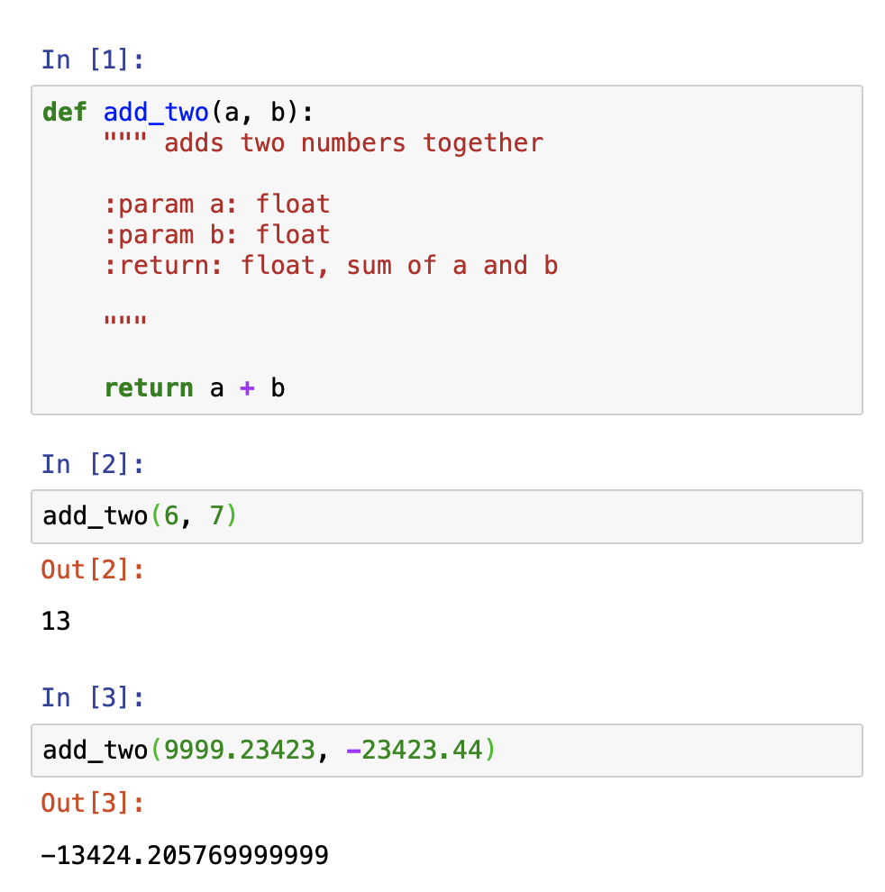
Documentation
Python example
Simple things matter: people need to understand your work
Clarity is Key
Can I come back and know what I did?
Can someone else read my code and understand it?
Can I/someone else take re-use pieces of my code?
Best practices:
Each piece of code has a clear purpose
Simple
Short
Don’t go nuts! Doesn’t need to be perfect.

Slide 24
Documentation
Python example
Helpful Tools:
Coding Standards (Python: pep8)
Unique, meaningful variable names
“mean_group_1” not “x_temp_modified”
Comment whenever the code is unclear, ambiguous or with several interacting parts
Re-used code is written as functions/classes
i.e. don’t copy and paste code over and over…

Slide 25
Documentation
Python example
Helpful Tools:
IDE: “Integrated development environment”
Program that can help you organize and develop a project
Often includes syntax review + version control
Matlab: (built in)
R: R-Studio
Python:
Pycharm (free for academics)
Visual Studio Code (free)
Project-level organization:
README.txt
What does each file do? How do you use the code?

Slide 26

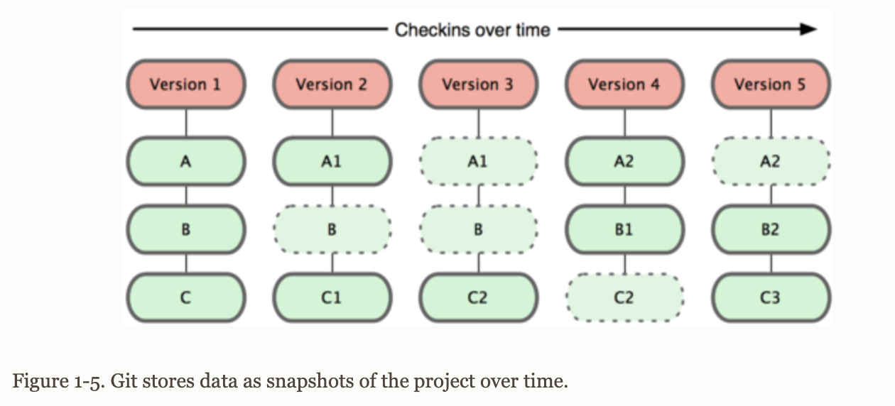
Version control
Why?
Can go back fix mistakes/bugs
Manage large projects with multiple people
GitHub easy way to share/collaborate
Git (local)/GitHub(online)
Stores snapshots over time.

Slide 27
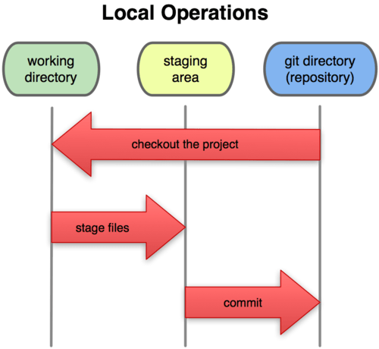
Git: basic concepts
Stage: snapshot of files
Commit: permanently store files in git
Push: copy local changes to repository
Pull: copy changes from repository to local
Merge: combine changes from different sources
Revert: go back to previous commit
Fork: create a copy of a GitHub repository in your account

Slide 28

Hosting code & data online
Why?
Build confidence in your work
Speed up new projects
People can
Answer questions on their own about your work
Ask new questions with your data/analyses
Good way to standardize practices
How?
Code:
Personal Website
GitHub
Resources:
Rmarkdown
Jupyter notebook
GoogleColab
Binder
…
Data
GitHub (non-sensitive only)
Openneuro.org (fMRI, MEG, EEG, iEEG, ECoG)

Slide 29
Demo
https://github.com/nicktfranklin/OpenScienceWorkshop2019

Slide 30
Preprints
Share early and share often!

Slide 31
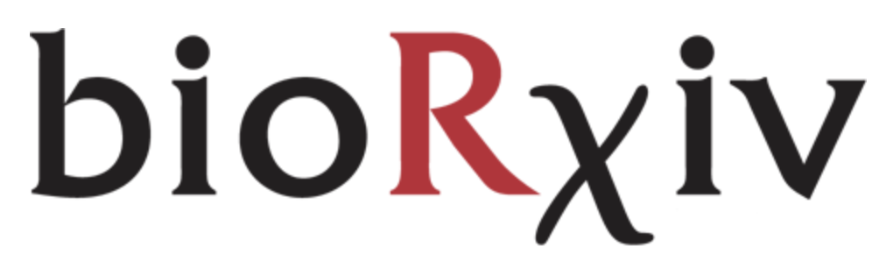

Preprints
Share your manuscripts early, before peer review process is completed
DOIs make it cite-able
Most journals are fine with it. Check the policy here: http://www.sherpa.ac.uk/romeo/index.php
Advantages
Pear review is important, but slow…
Others can read your work earlier
Cited earlier
Fairly well respected at this point
Track readership
Disadvantages
People may not read final product
arXiv
Notes:
That’s just for manuscripts though…

Slide 32
Sharing (all) research outputs in a citable, shareable, discoverable manner
Can slap a DOI on anything
“digital object identifiers”: unique universal object identifier

Slide 33
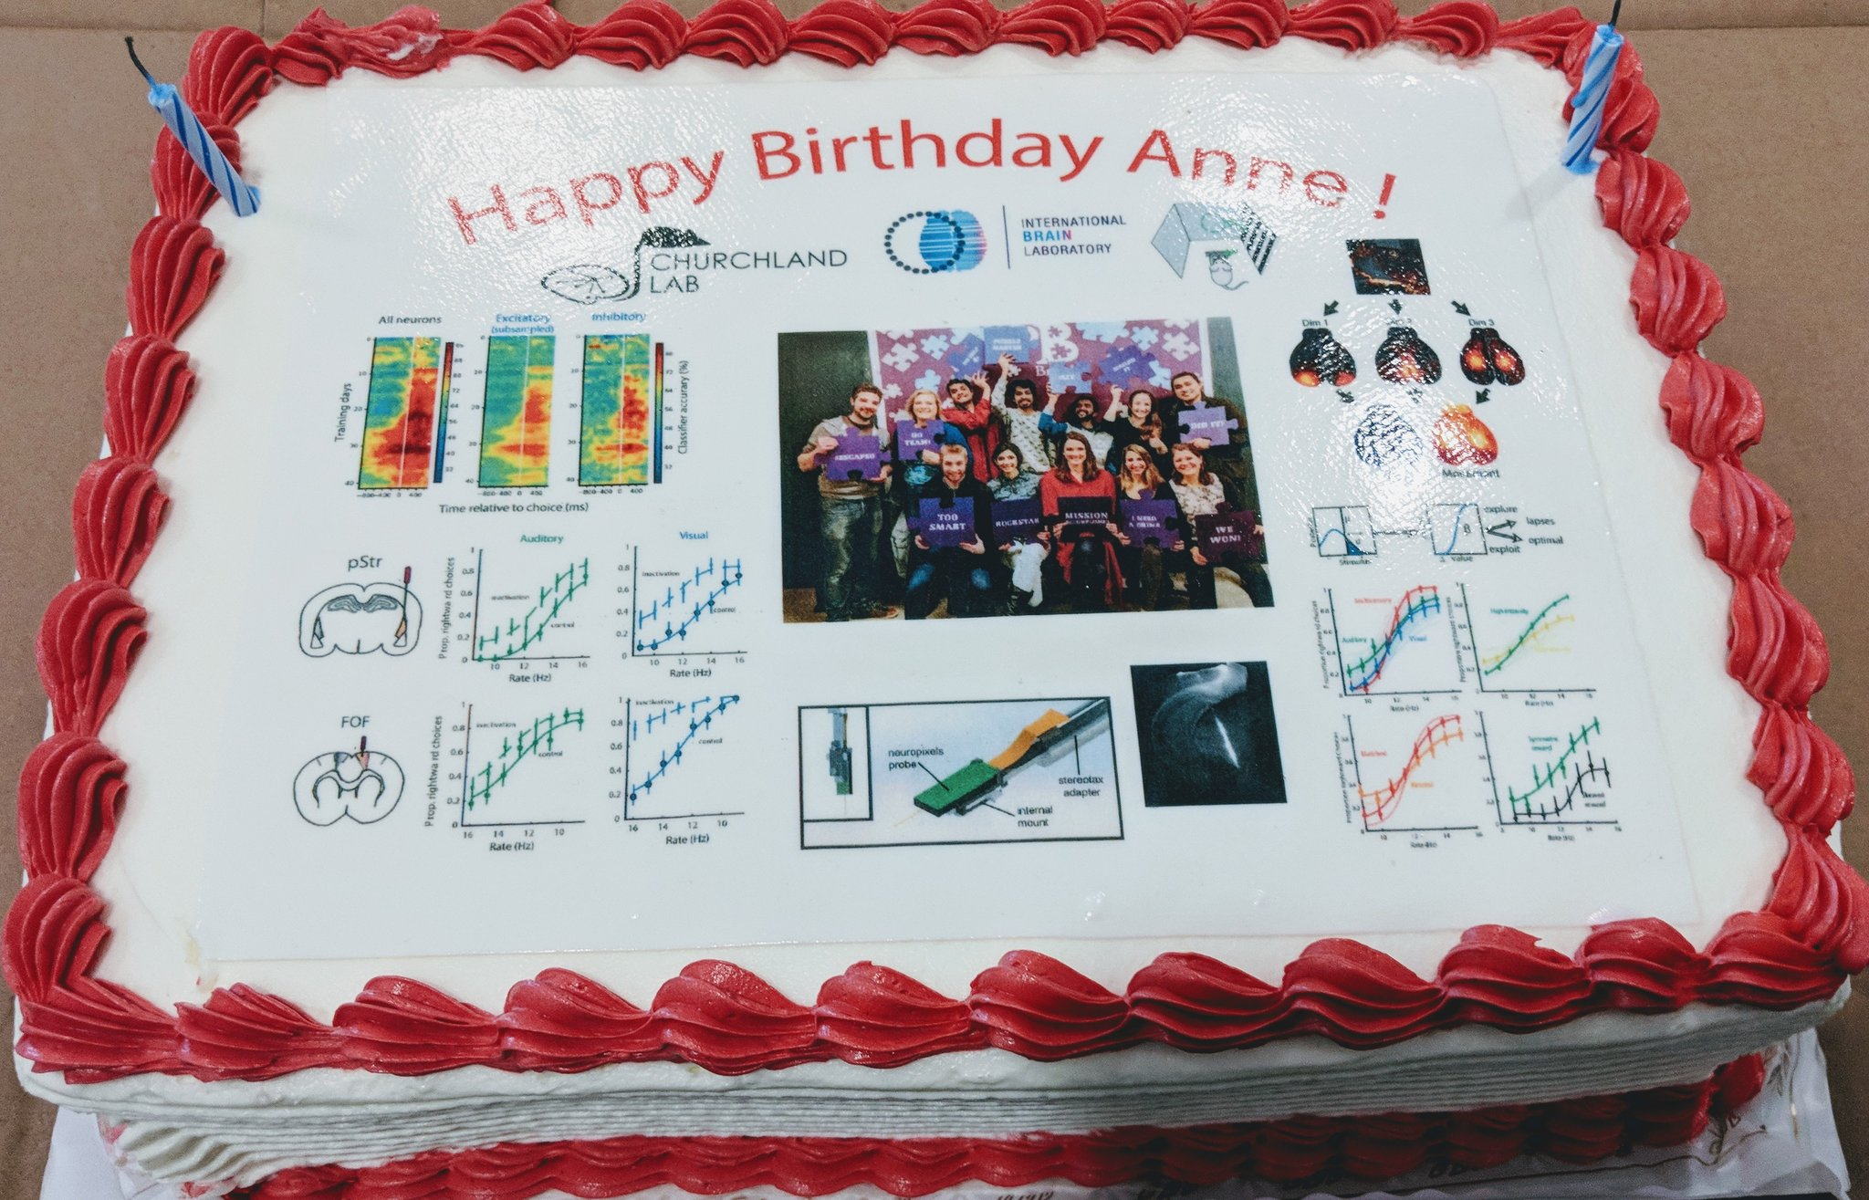
Churchland, A. K., Bekheet, G., Cascone, B., Chartarifsky, L., Juavinett, A. L., Musall, S., Najafi, F., Pisupati, S., Urai, A. (May 2018)The Churchland birthday data cake. http://dx.doi.org/10.14224/1.36589

Slide 34
Sharing (all) research outputs in a citable, shareable, discoverable manner
Can slap a DOI on anything
Institutional repositories
Figshare (free and paid plans)
Zenodo (free)
OSF (free)

Slide 35
Why NOT do open science?
Takes time
People might email you questions
You’re holding your work to a higher standard
Doesn’t count for job promotions
Requires additional skills
….

Slide 36
Why NOT do open science?
Takes time
People might email you questions
You’re holding your work to a higher standard
Doesn’t count for job promotions
Requires additional skills
….
Disseminate your work
Build confidence in your work
Better science

Slide 37




More effortful
to adopt
Lab-/collab-/field-wide pipelines, wikis, etc.
Registered reports
Tools &
Resources
Less effortful
to adopt
Notes:
** more effortful usually here means it involves multiple people being on the same page… or just more complicated systems to learn
** less effortful means quicker, easier, or fewer barriers to doing it by yourself
*****ORCID
***** Or even as simple as pacman load in R – little baby steps

Slide 38
Open science activity | Primary (majority) tools | Additional tools
Share code | GitHub | OSF
Share data | OSF | Zenodo, Figshare
Share posters, presentations, tutorials | Zenodo, Figshare | OSF
Share published manuscripts | ORCID, Google scholar | OSF, personal website, Zenodo, Figshare
Preregistrations | OSF
Registered reports | Journal
Preprints | PsyArXiv, bioRxiv, arXiv | OSF, personal website
”Notebooks” | Google colab, Jupyter Notebook, Rmarkdown, binder
Software compatability | Binder, Docker, Singularity

Slide 39
Thank You!
Demo and early version of the slides: https://github.com/nicktfranklin/OpenScienceWorkshop2019
Thanks to Stephanie DeCross

